Slide 1

Sentiment Analysis of Movie Reviews
Michael Yang
Notes:
Hi, my name is Michael yang, and my project was about the sentiment analysis of movie reviews.
I know two people already did their project on the same topic, so I’ll try to skip parts that overlap.

Slide 2
Table of Contents
Introduction
Problem
Applications
Methodology
Naïve Bayes/Bag of Words
Data
Challenges
Results & Analysis
Conclusion/Q&A
Problem & Applications
Methodology
Challenges
Results & Analysis
Conclusion
Data
Q&A
Notes:
To begin with, I’m going to give a general introduction to sentiment analysis, talking about the problem it tries to tackle and some applications.
Then I’ll talk about my program and the methodology behind it.
After that, I’ll go through my results and then conclude by analyzing these results and going over some possible improvements.

Slide 3
Problem
Categorizing vast textual data
Can be divided into two main domains: facts and opinion
Sentiment analysis aims to uncover the attitude of the author on a particular topic
Subjectivity
Polarity
Problem & Applications
Methodology
Challenges
Results & Analysis
Conclusion
Data
Q&A
Notes:
So as we know, there is a huge quantity of textual data on the internet, and these textual data can be roughly divided into two main domains: facts and opinions.
The task of sentiment analysis is to categorize the immense data, more specifically the opinions, to make them more useful.
This can be done in a number of different ways, but the most common way is to categorize the opinions by subjectivity and polarity.
By categorizing the opinions on the internet, we can basically find out how the internet feels about something at a given time, and we can apply this information to a lot of different stuff.

Slide 4
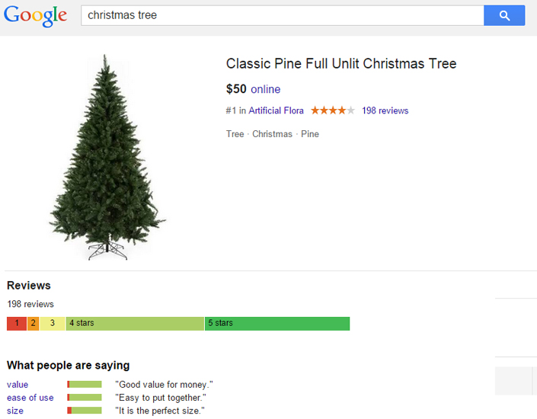
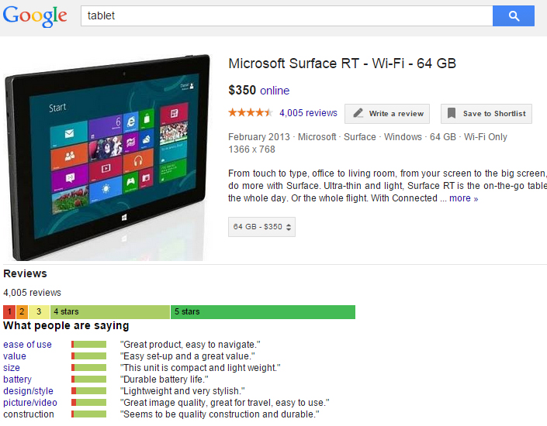
Applications
Figure 1. Google Product Reviews
Source: Google Shopping. <http://http://www.google.com/shopping>
Problem & Applications
Methodology
Challenges
Results & Analysis
Conclusion
Data
Q&A
Notes:
One example is google product reviews. Google product search automatically extracts information from the consumer reviews and detects the sentiment for certain attributes. As you can see here, the Christmas tree has attributes such as value and size, while the tablet has attributes such as battery or design. So what google does is it reads through all the reviews, and from each review, determine the sentiment, and finally aggregate these sentiments to give a nice summary of what people are saying. This red bar is the negative reviews and the green bar is the positive. So in both cases, you can see there are a lot more positive reviews than negative.

Slide 5
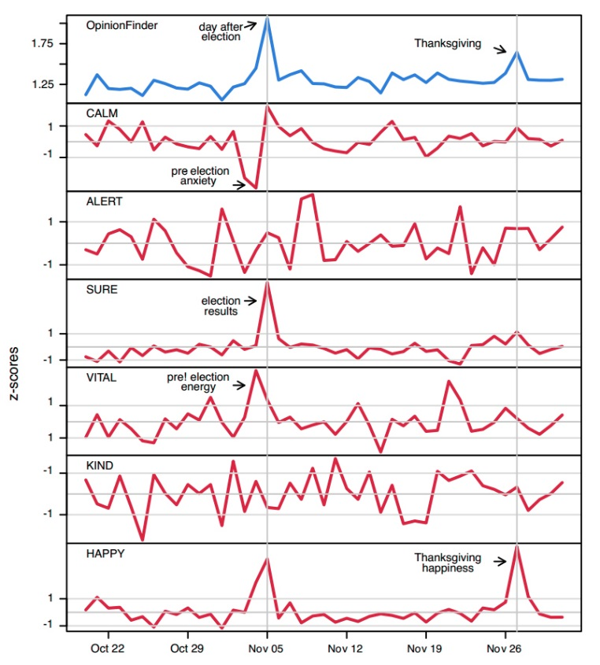
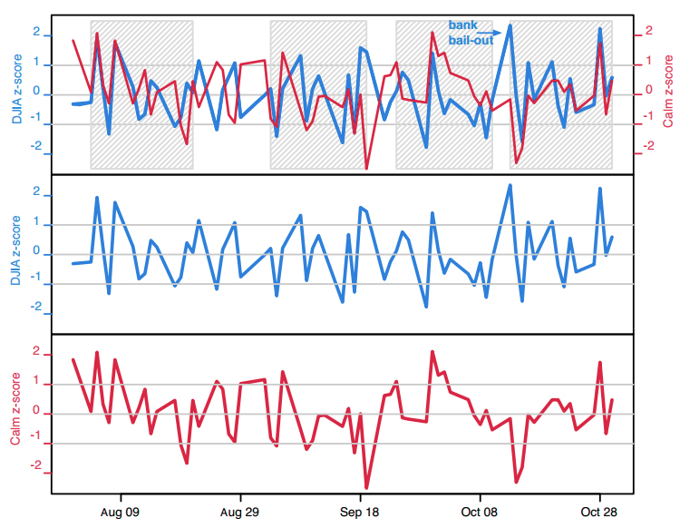
Applications
Twitter sentiment analysis
Extracted calmness, happiness, and various other sentiments
Calm z-score predicts the Dow Jones average 3 days later
Figure 3. Twitter Sentiment Analysis: Calmness and Dow Jones
Figure 2. Twitter Sentiment Analysis: Various Sentiments
Source: Johan Bollen, Huina Mao, Xiaojun Zeng. <http://arxiv.org/abs/1010.3003>
Problem & Applications
Methodology
Challenges
Results & Analysis
Conclusion
Data
Q&A
Notes:
Sentiment analysis can be also applied outside of products. As Jesse talked about in his presentation, there is currently a lot of interest in twitter sentiment analysis, and people were able to essentially predict the stock market using such information. Bollen et al extracted certain sentiments from twitter such as calmness, happiness, alertness, and they found that there’s a pretty decent correlation between the level of calmness from the tweets and the dow jones average 3 days later. Now all these applications require a lot of programming and data sets, so in order to make my project more realistic, I chose to write a program that determines the sentiment of a movie review.

Slide 6
My Program
Categorize movie reviews as positive or negative
Tokenization
Naïve Bayes
Bag of Words
Laplace Smoothing
Problem & Applications
Methodology
Challenges
Results & Analysis
Conclusion
Data
Q&A
Notes:
I used java to write my code, and unlike the two people who did this in python I didn’t have the luxury of using any premade kits or classifiers. So I basically had to make my own classifier, trainer, and tester, and what not. I actually used the tokenizer we had for our previous homework, and the approach I took was the same as Jesse’s which is Naiive bayes with bag of words and also laplace smoothing.

Slide 7


Naïve Bayes
Training Set
Test Review
The movie was really great! I especially loved the action scene.
The movie was really great! I especially loved the action scene.
Doc | Review | Polarity
1 | I really really loved this movie! | +
2 | The film was great. | +
3 | Really bad and boring. | -
4 | One of the worst movies I’ve seen. | -
Positive Reviews
really | loved | great | bad | boring | worst
2 | 1 | 1 | 0 | 0 | 0
really | loved | great | bad | boring | worst
3 | 2 | 2 | 1 | 1 | 1
Negative Reviews
really | loved | great | bad | boring | worst
1 | 0 | 0 | 1 | 1 | 1
really | loved | great | bad | boring | worst
2 | 1 | 1 | 2 | 2 | 2
$$p\left(+\right)=\frac{1}{2}$$
$$p\left(+|test\right)=\frac{1}{2}p(really|+)p\left(great | +\right)p\left(loved | +\right)=\frac{1}{2}\left(\frac{3}{10}\right)\left(\frac{2}{10}\right)\left(\frac{2}{10}\right)≈0.006$$
>
$$p\left(−\right)=\frac{1}{2}$$
$$p\left(−|test\right)=\frac{1}{2}p(really|−)p\left(great | −\right)p\left(loved | −\right)=\frac{1}{2}\left(\frac{2}{10}\right)\left(\frac{1}{10}\right)\left(\frac{1}{10}\right)≈0.001$$
Problem & Applications
Methodology
Challenges
Results & Analysis
Conclusion
Data
Q&A
Notes:
Now to give a brief overview on how naiive bayes actually works, I’ll just go over a mini example. I know we learned this in class, but its always good to just refresh our memories.
So here we have our training set of 4 reviews, 2 positive, 2 negative.
What we do first is define a dictionary. So my dictionary for this example consists of . then we count up how many times these occur for each sentiment. So here’s that. Then in order to deal with these pesky zeroes, I’ll do the same smoothing as I did in my program, which is add 1 or laplace smoothing.
Now let’s take our test review of
In order to apply the naiive bayes formula, we first need to probability of each polarity, which is simply ½. Then we calculate the probability of the review being positive given the test review and the probability of the review being negative given the test review.
And this is the basics of what my program does.

Slide 8
Training Data
Cornell Sentiment Polarity Dataset
1000 positive reviews & 1000 negative reviews
Usually about a paragraph each
Reviews for a wide range of movies
Leads to problems, especially with proper nouns and verbs
Problem & Applications
Methodology
Challenges
Results & Analysis
Conclusion
Data
Q&A
Notes:
Now for my training data, I used a dataset provided by the NLP group at cornell.
Their data consists of 1000 positive and 1000 negative reviews, about a paragraph each.
A very wide range movies was covered and this actually led to some problems with proper nouns and verbs, but I’ll talk about this more later. For my training Jennifer and Lawrence had a higher probability to be negative since there were reviews for movies she starred in for the negative training set, but not for the positive training set

Slide 9
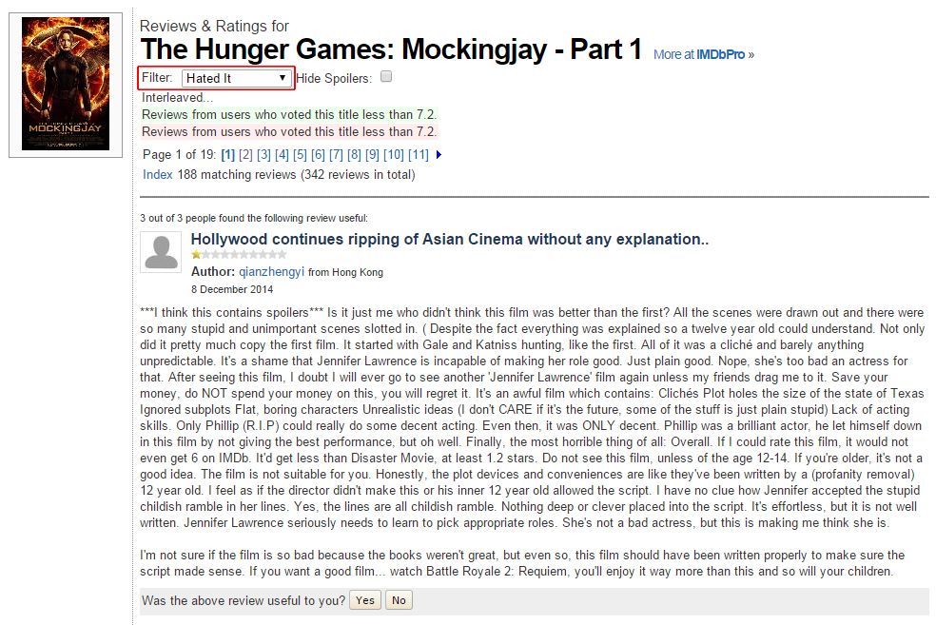
Test Data
IMDB – 50 positive and 50 negative reviews from 6 recent movies
Problem & Applications
Methodology
Challenges
Results & Analysis
Conclusion
Data
Q&A

Slide 10
Challenges
Typos
Negation
“I did not enjoy the movie at all.”
“I would never watch another film by him.”
Sarcasm/Ambiguity
“Honestly the best 3 hour nap I’ve ever had!”
“I thought this would be a great and exciting movie. I was wrong.”
Neutral words
Problem & Applications
Methodology
Challenges
Results & Analysis
Conclusion
Data
Q&A
Notes:
Some of the obvious challenges for this kind of programs is as follows: typos, negation, sarcasm, and neutral words. I guess the perks of writing my own trainer and classifier is that I can try and solve some of these problems myself, so for my program, I tried to deal with the problems of negation and neutral words. Negation is when you have a not or never which basically flips the meaning of the following word or words. Here you see “I did not”

Slide 11
Negation
Find keywords “n’t”, “not”, “never”
Change all following words to “!”+word, up to a punctuation mark
I didn’t like the movie.
I did n’t !like !the !movie.
Can potentially double the size of dictionary
Problem & Applications
Methodology
Challenges
Results & Analysis
Conclusion
Data
Q&A

Slide 12
Neutral Words
Due to the small training set, common neutral words may end up having a strong polarity
Depends on the nature of the movie of test reviews
Blacklist of common verbs, pronouns, and certain proper nouns
Be, is, are, was, were, etc.
I, he, she, they, etc.
“Mocking”, “Jennifer”, “Lawrence”
Problem & Applications
Methodology
Challenges
Results & Analysis
Conclusion
Data
Q&A

Slide 13
My Program
Tokenize training and test sets with negation rules
Make a dictionary
All the words of test reviews
Remove words on blacklist
Calculate probabilities using Naïve Bayes
Laplace smoothing
Compare the products for each test review
Problem & Applications
Methodology
Challenges
Results & Analysis
Conclusion
Data
Q&A

Slide 14
Results & Analysis
Figure 4. Results
Problem & Applications
Methodology
Challenges
Results & Analysis
Conclusion
Data
Q&A

Slide 15
Conclusion
Average accuracy of about 85%
Accuracy for negative reviews is higher
Numerous issues resulting from the small and broad training set
Negation/Blacklisting solves part of the problem
Possible improvements
Larger and focused training set
POS tagging
SentiWordNet
Problem & Applications
Methodology
Challenges
Results & Analysis
Conclusion
Data
Q&A

Slide 16

Questions?
Thank You!
Problem & Applications
Methodology
Challenges
Results & Analysis
Conclusion
Data
Q&A

